Slide 1
The Great White Throne
The heavens and Earth Pass Away and Unbelievers are judged

Slide 2
Revelation 12:11-15
Then I saw a great white throne and Him who sat upon it, from whose presence earth and heaven fled away, and no place was found for them. 12 And I saw the dead, the great and the small, standing before the throne, and books were opened; and another book was opened, which is the book of life; and the dead were judged from the things which were written in the books, according to their deeds. 13 And the sea gave up the dead which were in it, and death and Hades gave up the dead which were in them; and they were judged, every one of them according to their deeds. 14 Then death and Hades were thrown into the lake of fire. This is the second death, the lake of fire. 15 And if anyone’s name was not found written in the book of life, he was thrown into the lake of fire.

Slide 3
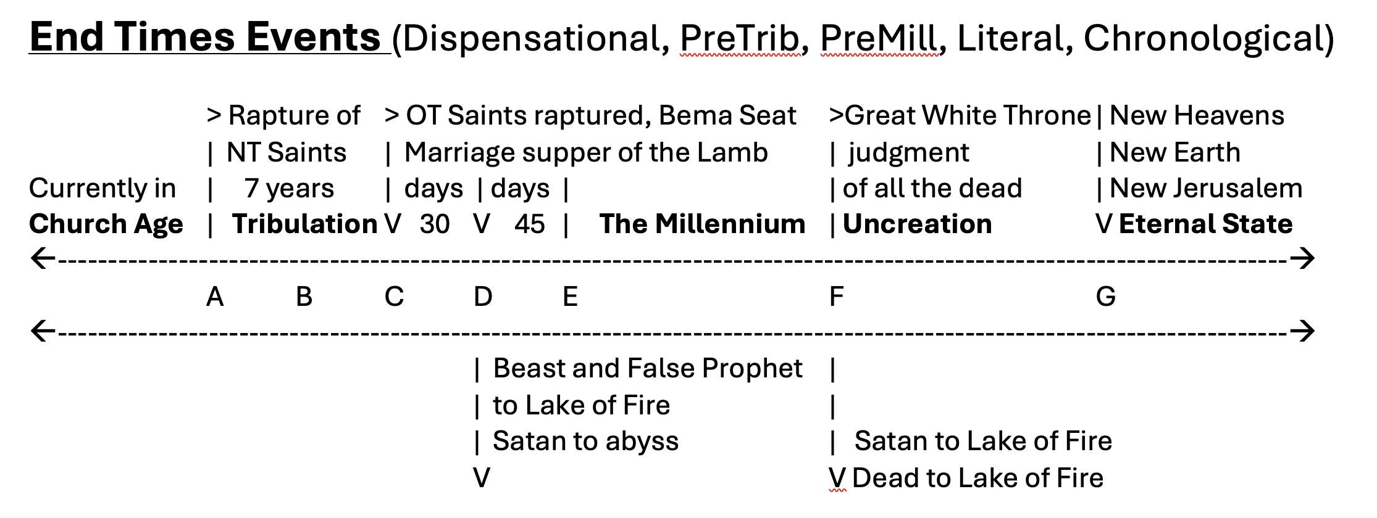
NT Saints are raptured. The Tribulation begins. Antichrist makes a covenant with Israel.
Midpoint of Tribulation, Antichrist breaks the covenant with Israel. Temple sacrifice is abolished.
Armageddon. Purging. The Great “Supper” of God. OT Saints Raptured (Dan12:1-2, 10-11)
Christ brings blessing to earth and prepares the earth for the Millennial Kingdom (Dan 12:12-13).
The Millennium begins. All the saints rule with Christ for 1,000 years (Rev 12:4).
The “dead” are judged for their “works”. Possibly Millennium saints are also judged (Rev 12:5-6).
New Heavens and New Earth are created. New Jerusalem descends from heaven (Rev 21:1-2).

Slide 4
Bema Seat of Judgment
2 Cor 5:9-10, Therefore we also have as our ambition, whether at home or absent, to be pleasing to Him. 10 For we must all appear before the judgment (bema) seat of Christ, so that each one may be recompensed for his deeds in the body, according to what he has done, whether good or bad.
What does “recompensed” mean?

Slide 5
Bema Seat of Judgment
Are there different degrees of reward?
1 Cor 3:10-15, According to the grace of God which was given to me, like a wise master builder I laid a foundation, and another is building on it. But each man must be careful how he builds on it. 11 For no man can lay a foundation other than the one which is laid, which is Jesus Christ. 12 Now if any man builds on the foundation with gold, silver, precious stones, wood, hay, straw, 13 each man’s work will become evident; for the day will show it because it is to be revealed with fire, and the fire itself will test the quality of each man’s work. 14 If any man’s work which he has built on it remains, he will receive a reward. 15 If any man’s work is burned up, he will suffer loss; but he himself will be saved, yet so as through fire.

Slide 6
Great White Throne Judgment
QUESTION: Are there different degrees of punishment?
Mat 10:15, Truly I say to you, it will be more tolerable for the land of Sodom and Gomorrah in the day of judgment than for that city.
Mar 12:40 40 who devour widows’ houses, and for appearance’s sake offer long prayers; these will receive greater condemnation.”
Rom 2:5, But because of your stubbornness and unrepentant heart you are storing up wrath for yourself in the day of wrath and revelation of the righteous judgment of God.

Slide 7
Great White Throne Judgment
Who is on the throne?
  The judge of all the earth, Who is he?
  Act 7:30-31, Therefore having overlooked the times of ignorance, God is now declaring to men that all people everywhere should repent, 31 because He has fixed a day in which He will judge the world in righteousness through a Man whom He has appointed, having furnished proof to all men by raising Him from the dead.”
  2 Tim 4:1-2, I solemnly charge you in the presence of God and of Christ Jesus, who is to judge the living and the dead, and by His appearing and His kingdom: 2 preach the word

Slide 8
THE UNCREATION OF THE UNIVERSE
QUESTION: Why does the entire universe need to be uncreated?
QUESTION: What would it mean for it to be uncreated?
QUESTION: What was here before the creation?
2 Pet 3:10, But the day of the Lord will come like a thief, in which the heavens will pass away with a roar and the elements will be destroyed with intense heat, and the earth and its works will be burned up.

Slide 9
High School Physics lesson
    Matter consists of “particles” in constant motion.
      Motion is distance over time (miles per hour, feet per second)
    What causes the particles to be in constant motion?
      Energy: the “capacity to apply force”
      When force is applied, this is called power
      When power is expended over time this is called work
    Both energy and matter can behave as both waves and particles
      wave equations for matter are known as de Broglie equations
      particle equations for energy are known as Quantum equations

Slide 10
Quantum Physics lesson
  Both matter and energy demonstrate similar (interchangeable) characteristics
    In many ways, matter can be considered “solidified energy”.
      Albert Einstein said this: “It followed from the special theory of relativity that mass and energy are both but different manifestations of the same thing — a somewhat unfamiliar conception for the average mind.”
  Matter has four fundamental forces: Strong, Weak, Electromagnetic and Gravity
    Strong force holds the atom together (no one can explain what it is) NUCLEAR
    Weak force holds molecules together (atoms to atoms) CHEMICAL
    Electromagnetic can either push or pull depending on charge
    Gravity, the weakest force, causes masses to attract, but has infinite range

Slide 11
Bible Physics Lesson
  Scientists agree that all these forces (energies) inside matter are in perfect balance.
    If any one of them were greater or smaller, matter would NOT exist.
  We also know from the bible that the entire universe is held together by Jesus himself.
    Col 1:15-17, He is the image of the invisible God, the firstborn of all creation. 16 For by Him all things were created, both in the heavens and on earth, visible and invisible, whether thrones or dominions or rulers or authorities—all things have been created through Him and for Him. 17 He is before all things, and in Him all things hold together.

Slide 12
Einstein’s Theory of Special Relativity
  E = mc² m = 1 kilogram (2.2 pounds) of matter, c = 300,000,000 meters/second
  E = (1)(300,000,000)²
  E = 90,000,000,000,000,000 joules (90 quadrillion joules, one joule is 1 watt)
  E = 90,000,000,000 megawatts (90 billion megawatts)
  E = 90,000 million megawatts (the United States uses a million megawatts per second)
  The energy bond up in 1 Kilogram of matter will power the entire Unites States electrical grid for 90,000 seconds, or one full day.

Slide 13
the earth and its works will be burned up
So how will the elements melt with intense heat?
  The sense is all God has to do is remove his hand from the delicate balance of forces inside the atom and the creation will melt away (convert back into pure energy).
  Another view is that because matter consists of particles in constant motion, all God has to do here is remove time from the creation.
    If time is eliminated, there can be no motion
    If motion ceases, then matter itself will cease to exist

Slide 14
And I saw the dead, the great and the small, standing before the throne
When the earth and the universe melt away, they give up all the dead unbelievers from the beginning of time.
They’re given eternal bodies and are standing before the Great White Throne awaiting judgment.
QUESTION: What does “the great and small mean”?
  Those considered important in human terms, standing right next to the insignificant
This is the “resurrection of judgment”
  John 5:28-29, Do not marvel at this; for an hour is coming, in which all who are in the tombs will hear His voice, 29 and will come forth; those who did the good deeds to a resurrection of life, those who committed the evil deeds to a resurrection of judgment.
  Dan 12:2, Many of those who sleep in the dust of the ground will awake, these to everlasting life, but the others to disgrace and everlasting contempt.

Slide 15
And the sea gave up the dead which were in it, and death and Hades gave up the dead which were in them
The sense here is God has recovered “the dead” from all over the planet, no matter where they are.
Their souls have been in Hades, and their earthly bodies have been in “death” and the seas.
In order to be standing before the throne, they have been given eternal bodies
  Rom 9:21-24 (NLT), God has the right to show his anger and his power, he is very patient with those on whom his anger falls, who are destined for destruction
    Destruction: perdition, loss, waste, ruin
  Luke 16:22-24, Send Lazarus over here to dip the tip of his finger in water and cool my tongue. I am in anguish in these flames.’

Slide 16
The Books of deeds Are Opened
and books were opened; and another book was opened, which is the book of life; and the dead were judged from the things which were written in the books, according to their deeds. 13 And the sea gave up the dead which were in it, and death and Hades gave up the dead which were in them; and they were judged, every one of them according to their deeds.
  Dan 7:9-10 ⁹“I kept looking Until thrones were set up, And the Ancient of Days took His seat; His vesture was like white snow And the hair of His head like pure wool. His throne was ^{[a]}ablaze with flames, Its wheels were a burning fire.¹⁰ “A river of fire was flowing And coming out from before Him; Thousands upon thousands were attending Him, And myriads upon myriads were standing before Him; The court sat, And the books were opened.
  Mat 12:36 ³⁶ But I tell you that every ^{[a]}careless word that people ^{[b]}speak, they shall give an accounting for it in the day of judgment.

Slide 17
The Book of Life is Opened
The Book of Life
  Similar to the registry of citizens kept by ancient cities
  Phil 3:20 For our citizenship is in heaven, from which also we eagerly wait for a Savior, the Lord Jesus Christ
  Dan 12:1 at that time your people, everyone who is found written in the book, will be rescued.

Slide 18
How are the dead judged?
82 percent of Americans believe in an afterlife that includes both heaven and hell, but only 4 percent of those people believe that they will go to hell. (James Patterson and Peter Kim, The Day America Told the Truth (New York: Prentiss Hall Press, 1991), p. 204.)
The problem is God’s standard requires absolute perfection.
  Psa 53:1-3, There is no one who does good, not even one. (quoted in Rom 3:10)
  Mat 5:48 NLT, But you are to be perfect, even as your Father in heaven is perfect.
  Rom 3:23, for all have sinned and fall short of the glory of God
  James 2:10 NLT, For the person who keeps all of the laws except one is as guilty as a person who has broken all of God’s laws.

Slide 19
Good deeds?
  What are the chances our good deeds can get us into heaven?
  But the dead want to be judged by their deeds, despite God’s free provision!
    To them that’s preferable to being accountable to God’s moral standard
    What’s the error here?
      Comparing ourselves with others!
      2 Cor 10:12, 18, For we are not bold to class or compare ourselves with some of those who commend themselves; but when they measure themselves by themselves and compare themselves with themselves, they are without understanding. 18 For it is not he who commends himself that is approved, but he whom the Lord commends.
      QUESTION: Who shall we measure ourselves by?

Slide 20
14 Then death and Hades were thrown into the lake of fire. This is the second death, the lake of fire. 15 And if anyone’s name was not found written in the book of life, he was thrown into the lake of fire.
The place has already been prepared and made ready!
  Mat 25:41, “Then He will also say to those on His left, ‘Depart from Me, accursed ones, into the eternal fire which has been prepared for the devil and his angels;
Who were the first two occupants?
When were they thrown in there?
Who was also recently thrown in there?
Now, all the “dead” from all ages on planet earth are thrown in there with them.
Notice the word “thrown”
  When do we “place” things somewhere?
  When do we “throw” things somewhere?

Slide 21
IS your name written in the book of life?
“Book of Life”
  This exact phrase occurs 8 times in the entire bible: Psalms and Philippians once each.
  The other 6 in Revelation
“In your book”
  This exact phrase occurs twice in Psalms
    Psa 139:16, And in Your book were all written the days that were ordained for me,
“blot” with “book” four times
  Some claim these verses imply that a name can be erased. This is not true.
    See Rev 3:5, “I will not erase his name from the book of life”
Bottom line: If you have put your trust in Jesus for your salvation, your name is in there!

Slide 22
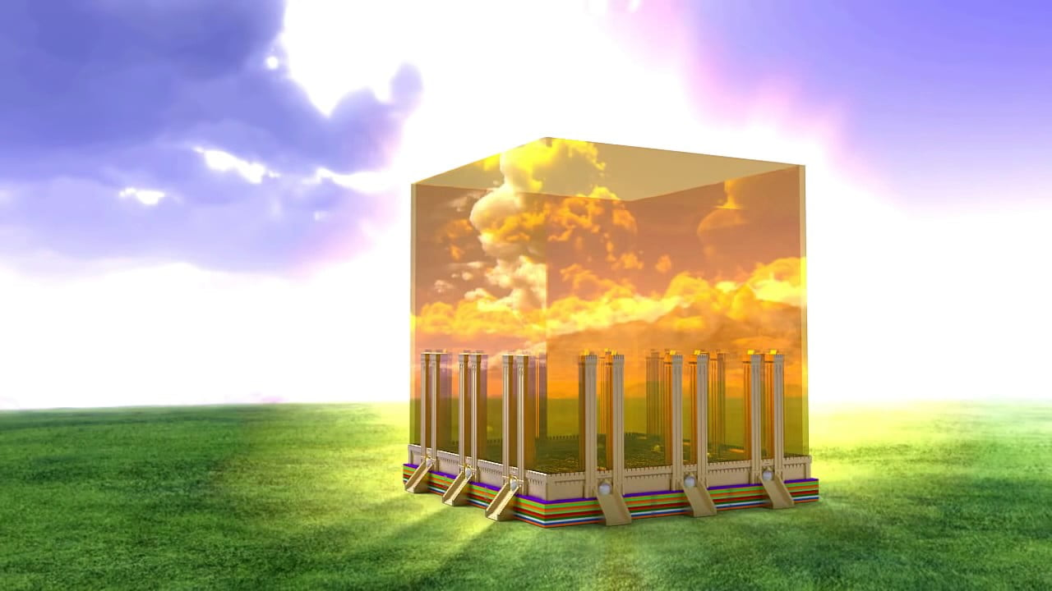
Next and Final Session – Heaven – The eternal State

